Slide 1


EarthScope
TM

Slide 2
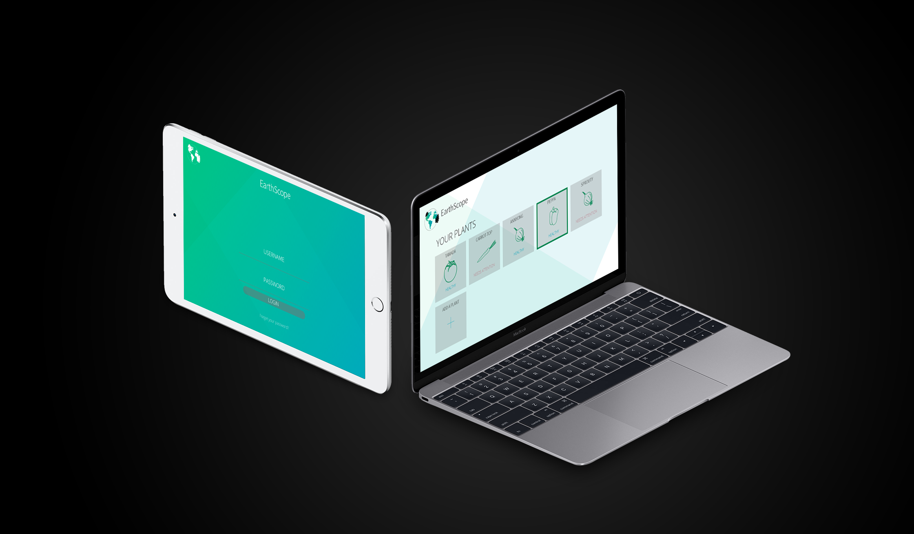

Slide 3
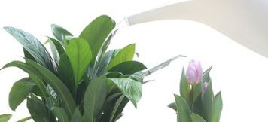
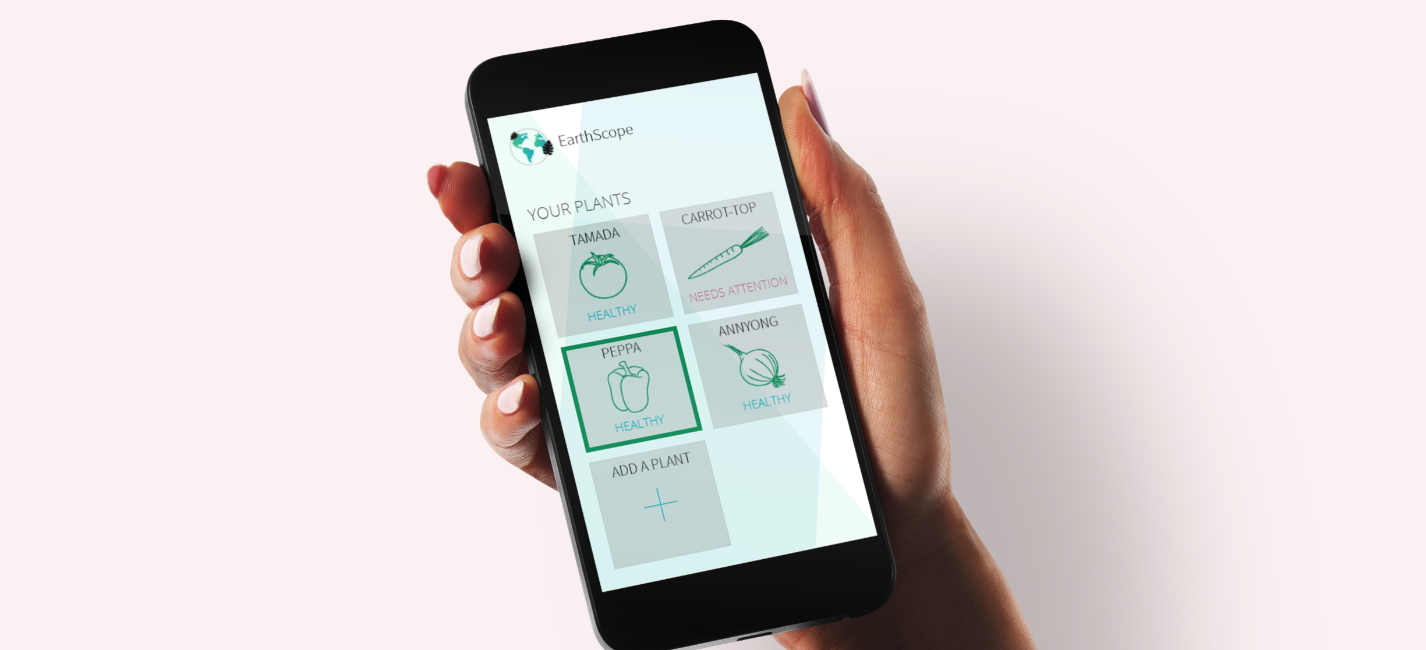
The EarthScope
The EarthScope is an in-plant monitoring device designed to keep you in-touch with your plant’s health.
The EarthScope’s works in tandem with a companion app which gives plant lovers the ability to monitor their plants health in real-time.

Slide 4

Functionality
The EarthScope comes packaged with three built-in sensors.
These sensors read each plant’s moisture levels, soil temperatures, and sunlight levels, and relay the information to the companion app.

Slide 5
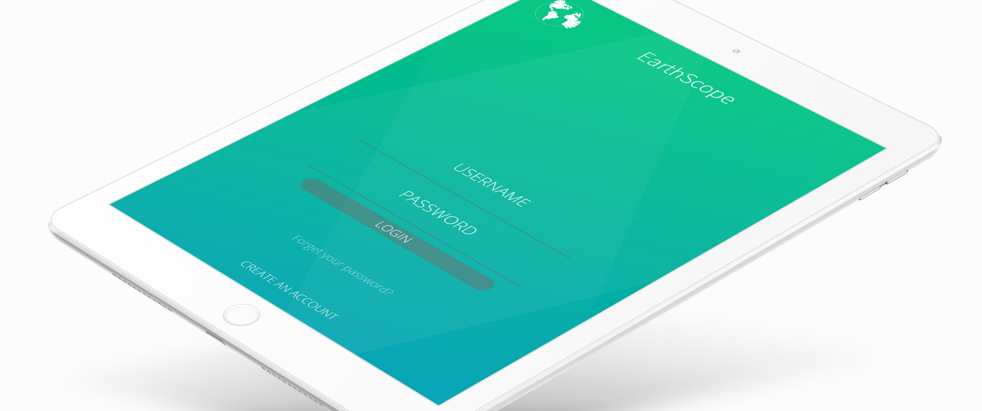
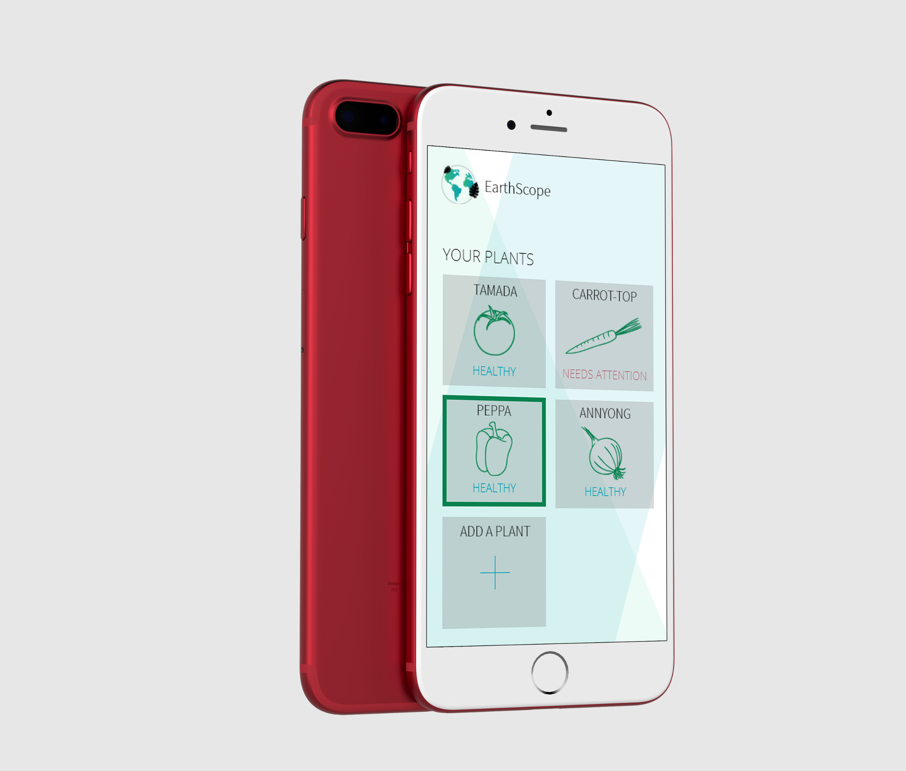

An app for plant
hobbyists.
The EarthScope app is designed with gardening enthusiasts in mind.
The app gives users an interface to register their plants, view various diagnostics, and establish plant watering schedules.

Slide 6
OUR GOALS
1. The EarthScope is an in-plant monitoring device designed to keep you in-touch with your plant’s health.
2. The EarthScope is an in-plant monitoring device designed to keep you in-touch with your plant’s health.
3. The EarthScope is an in-plant monitoring device designed to keep you in-touch with your plant’s health.

